Slide 1
The Hunger Games
Date and title your work. Underline the title.

Slide 2
How else can we learn about a book?
A blurb is a short summary accompanying a story…
WINNING WILL MAKE YOU FAMOUS. LOSING MEANS CERTAIN DEATH.
In a dark vision of the near future, twelve boys and twelve girls are forced to appear in a live TV show called the Hunger Games. There is only one rule: kill or be killed.
When sixteen-year-old Katniss Everdeen steps forward to take her sister’s place in the games, she sees it as a death sentence. But Katniss has been close to death before. For her, survival is second nature.
What is the most interesting sentence in the blurb do you think? Why?
Task: Write down three questions you (or someone who hasn’t read the book before) might have about the book based on the blurb: “The questions I have about this book are:…”
Challenge:
What is the effect of the colon? How has the writer used sentences for effect?
Notes:
2

Slide 3

Learning objective:
To make inferences about a text.
Why is the skill of inference important in English?

Slide 4

The first page…
Stick your copy of the first page into your books.
Think about…
What questions does the author want you to ask?
Write your questions around the side of the extract, drawing arrows from the key part of the text.
What inferences does the author want you to make?
Extension: What do you notice about the sentences at the end of the first two paragraphs? Why has the author done this?

Slide 5
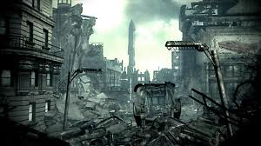
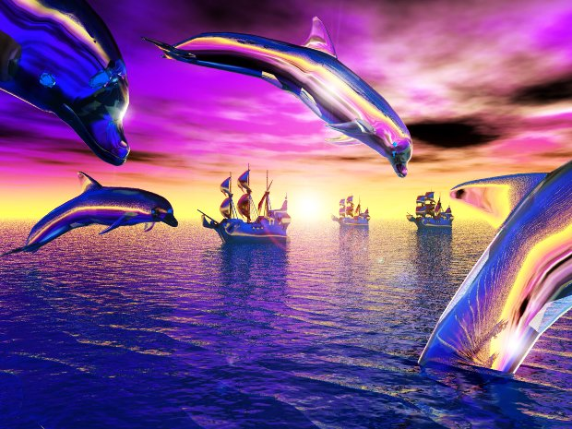
Homework:
What is Dystopian Literature?
What is Utopian Literature?

Slide 6

Let’s begin reading…
Chapter 1…
(pages 3 – 17)

Slide 7
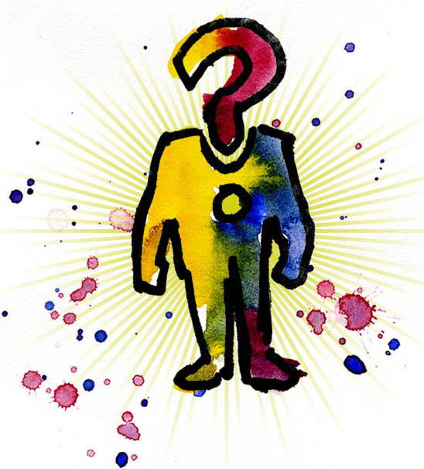
How has Suzanna Collins presented the character of Prim in the first chapter? What is the effect of this?
Each pair will be given a quotation about Prim, which you will need to analyse and teach to the rest of the class.
Notes:
7

Slide 8



What can you infer about the character of Prim from your quotation?
How do you start analysing a quotation?
Underline the key words in your quotation.
Answer your key questions, trying to give more than one interpretation and going into lots of detail when inferring and analysing.
What questions can you ask about the key words you have underlined?
Notes:
10 mins

Slide 9
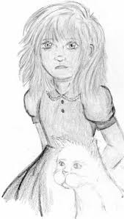
Prim
Stick your copy of the ‘Prim’ quotation sheet in your book.
As each group feeds back to the class, make sure you are making analysis notes on your own copy of the sheet.
Notes:
Then finish reading Chapter 1.

Slide 10
Learning Objective: To make inferences about a text.
What language technique has been used here?
“Prim’s face is as fresh as a raindrop, as lovely as the primrose for which she was named.” (pg 3)
What does a raindrop symbolise? How can this be related to the character of Prim?
What does a primrose symbolise? What does this suggest about the character of Prim?
How might this quotation make the reader feel towards the character of Prim?

Slide 11
Learning Objective: To make inferences about a text.
Why has the word ‘guarding’ been used? What does this suggest about Prim?
Sitting at Prim’s knees, guarding her, is the world’s ugliest cat… Prim named him Buttercup insisting that his muddy yellow coat matched the bright flower.” (pg 4)
What does a Buttercup symbolise? Why is this a strange name to give to the cat and what does it suggest about Prim that she chose it?
What do Prim’s actions here demonstrate about her personality?
What does the word ‘insisting’ suggest about her personality?
How might this quotation make the reader feel towards the character of Prim?

Slide 12
Learning Objective: To make inferences about a text.
What does light hair imply about Prim’s personality?
“My mother and Prim with their light hair and blue eyes always look out of place.” (pg 9)
What does the colour blue symbolise? What could this imply about Prim’s personality?
Why has the writer specifically said that Prim always looks out of place? How might her character be different to the others around her?
How might this quotation make the reader feel towards the character of Prim?

Slide 13
Learning Objective: To make inferences about a text.
What does the word ‘first’ imply about Prim’s experience and feelings today?
“Prim is in my first reaping outfit, a skirt and ruffled blouse. It’s a bit big on her, but my mother has made it stay with pins.” (pg 17)
Why has the author dressed Prim in a skirt and blouse? How does this make her look to the audience? What does it imply about her personality?
Why has the author chosen to tell the reader that Prim’s mother has “made it stay with pins”? What does this imply about Prim?
Why has the author chosen to tell the reader that the clothes are a bit big for Prim? What is the effect of this?
How might this quotation make the reader feel towards the character of Prim?

Slide 14


Plenary: Why did Suzanne Collins present Prim in this way during chapter 1? What is the effect on the reader when Prim gets chosen?
Challenge: In the last couple of paragraphs, how has the writer used repetition and sentences to build up tension?

Slide 15
Homework
Due tomorrow
Research:
What Utopian literature is
What Dystopian literature is

